Slide 1


COMP1030 Lecture #2
Introduction to java

Slide 2
Housekeeping
Our goal - 100% pass rate in this course.
Review the lecture slides ahead of time.
Review the lecture slides after class with a study group.
Repeat the lab at home 1-2 times.
Take notes during class.

Slide 3
Review
Advantages of java over C++
Java vs javascript
OO concepts
JVM
javadoc
PATH variable
javac.exe (JDK)
Java.exe (JRE)

Slide 4
Java comments
Java supports 3 styles of commenting
// for comments on one line
/* for comments on
multiple lines */
/** javadoc comments */

Slide 5
Java comments
Course comment standards
A meaningful comment for each code section
Every program to begin with:
/** Application Purpose:
* Author:
* Date:
* Time:
*/

Slide 6
Semicolons, blocks and whitespace
A statement is single line of code terminated by a ;
Total = a + b + c;
A block is a collection of statements bounded by opening and closing braces. Blocks can be nested.
{
code here
}
Notice the tabbed whitespace – this is convention not syntax

Slide 7
Whitespace
Whitespace is ignored by the compiler, therefore any amount of whitespace is allowed.
Use whitespace to enhance program readability

Slide 8
Identifiers
Identifiers are names given to variables (state) , classes (blueprints for objects) and methods (behaviour)
An identifier is a series of characters consisting of letters, digits, underscores and $.
Identifiers cannot begin with a digit, cannot be an underscore alone, or cannot
contain whitespace

Slide 9
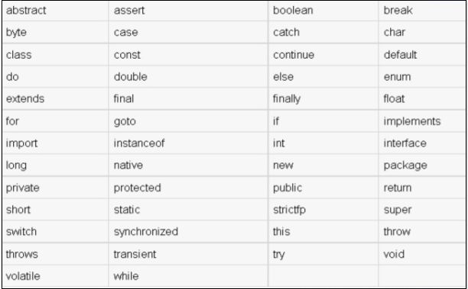
Java keywords

Slide 10
Java types
Logical boolean
Textual char, String
Integral byte, short, int, long
Floating double, float

Slide 11
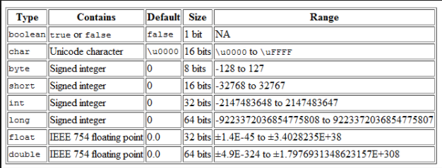
Java types

Slide 12
Java String class
String is one of the few classes which supports “implicit” instantiation
The java String class is part of the java.lang package
Strings are immutable
A String has its literal enclosed in double quotes
Example: String errormsg = “Record Not Found”

Slide 13
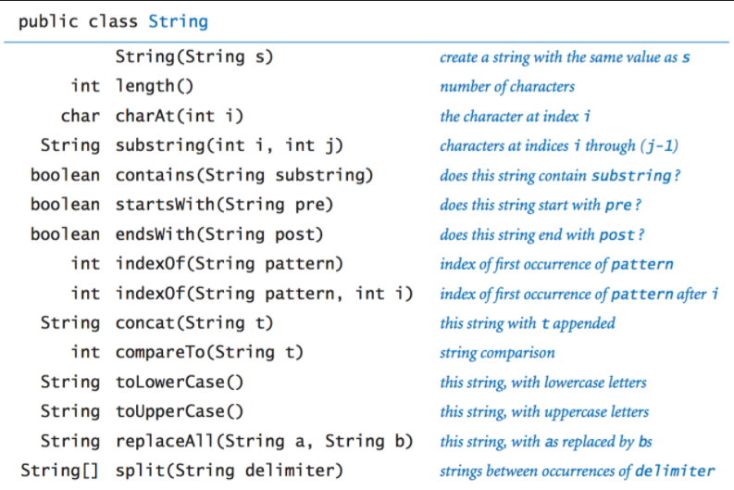
Java String methods

Slide 14
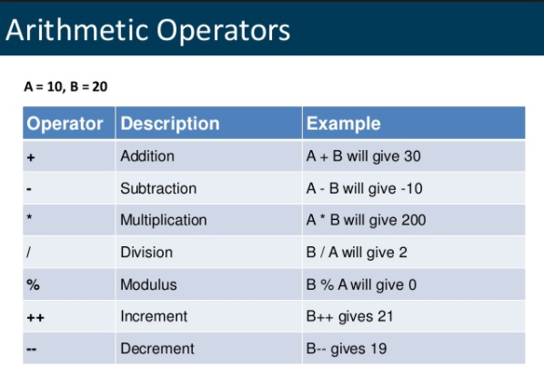
Java Arithmetic Operators

Slide 15
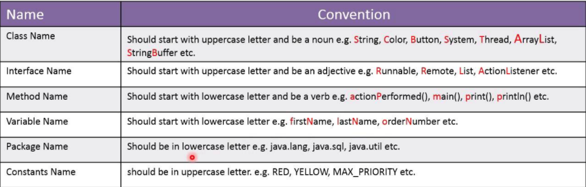
Java Programming Conventions

Slide 16
Java import statement
The import statement provides a mechanism to make specific functionality (classes) available to your program code.
The import statement is required to use any class that is not automatically imported by your program code.
By convention the import statement is
written directly before the class definition.

Slide 17
Java import statement
The only exception to this rule are classes that exist within the java.lang package. These classes are automatically available to the compiler without importing them.
However, the compiler will not complain if you import them anyway.

Slide 18
Class declaration
To declare a class in java you simply use the keywords public (most often) and class and the name of the class using the appropriate naming convention. All code within the class is indented.
public class Employee
{
code…
code…
}

Slide 19
The main method
From lab #1 we have seen that in order to execute a java program we need to execute the runtime environment by typing:
java ClassName
Gosling designed java such that when you run
“java” it will only look for one thing – a
method called main – which, generally
speaking, must look like this:
public static void main (String [] args)

Slide 20
Variable Assignment
To assign a value to a variable you need three things:
An identifier
The assignment operator
A value to assign (literal or another variable)
A Type
int age = 32;

Slide 21
Displaying information
To display information on the screen we use a built in java function called println.
System.out.println(“hello”);
System.out.println(age);

Slide 22
The + operator
The “+” operator is context sensitive, based upon the operands on either side.
3 + 5 means addition: 8
“3” + “5” mean concatenation: “35”
System.out.println(“hello” + “world”)
will display “helloworld” on the screen.

Slide 23
charAt
The charAt() method is functionality that lives in the String object.
It is used to determine the character at a specific location in a string.
All Strings are zero indexed.

Slide 24
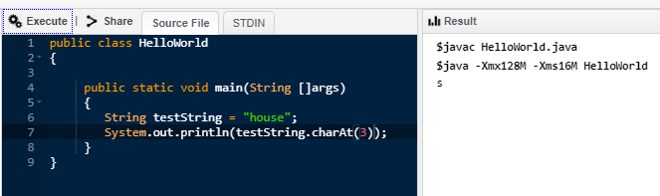
charAt

